Slide 1
HDInsight_Activity

Slide 2
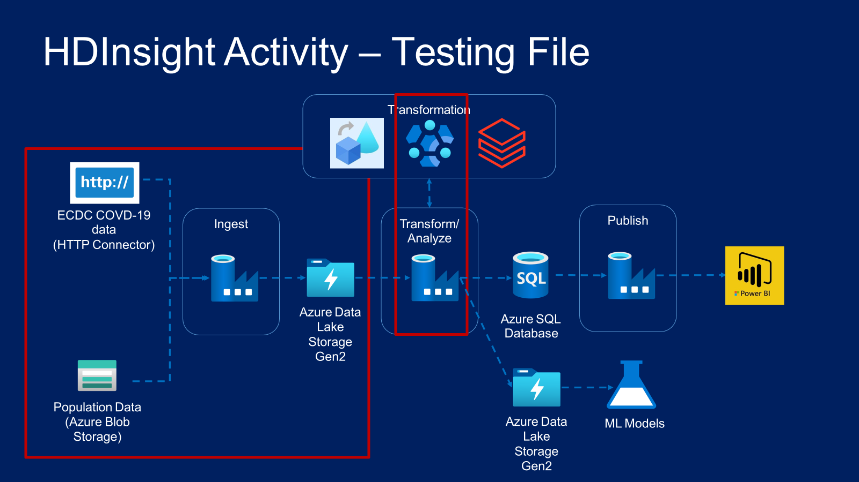

Slide 3
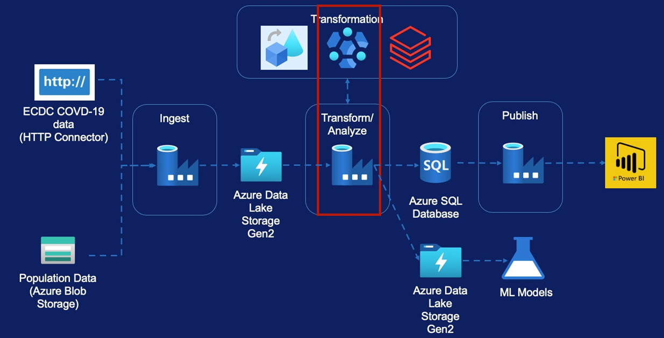
HDInsight Activity – Testing File
Creating HDInsight Cluster
HDInsight UI Overview
Transformation Requirement
Hive Script Walk-through
Creating Pipeline
Delete HDInsight Cluster

Slide 4
Creating HDInsight Cluster
Testing Data

Slide 5
